Slide 1
Agenda
Cross-Cutting Concern &
Observability Patterns
Cross-Cutting Concern Patterns
  Externalized Configuration
  Service Discovery
  Circuit Breaker
  Retry Pattern
  Rate Limiting Pattern
Observability Patterns
  Microservices Logging
  Microservices Tracing
  Microservices Monitoring

Slide 2
Cross Cutting Concern Patterns
Problem: How to handle cross-cutting concerns?
Externalized configuration - externalize all configurations such as database location and credentials
Service discovery - How does the client of an RPI-based service discover the network location of a service instance?
Circuit Breaker - invoke a remote service via a proxy that fails immediately when the failure rate of the remote call exceeds a threshold
Notes:
The crosscutting concern is a concern which is applicable throughout the application and it affects the entire application. For example: logging, security and data transfer are the concerns which are needed in almost every module of an application, hence they are cross-cutting concerns.

Slide 3
Externalized Configuration: Azure Key Vault
Azure Key Vault is a safe place to store passwords, connection strings, access codes, and certificate keys
Fully managed by Azure, so you don’t have to worry about the underlying infrastructure.
You can use Azure Key Vault from your .NET application using the Azure.Security.KeyVault.Secrets NuGet package
Notes:
Tenant: A tenant is the organization that owns and manages a specific instance of Microsoft cloud services. It’s most often used in an exact manner to refer to the set of Azure and Office 365 services for an organization.
Vault owner: A vault owner can create a key vault and gain full access and control over it. The vault owner can also set up auditing to log who accesses secrets and keys. Administrators can control the key lifecycle. They can roll to a new version of the key, back it up, and do related tasks.
Resource: A resource is a manageable item that's available through Azure. Some common resources are a virtual machine, storage account, web app, database, and virtual network, but there are many more.
Resource group: A resource group is a container that holds related resources for an Azure solution. The resource group can include all the resources for the solution, or only those resources that you want to manage as a group. You decide how you want to allocate resources to resource groups, based on what makes the most sense for your organization.
Vault consumer: A vault consumer can perform actions on the assets inside the key vault when the vault owner grants the consumer access. The available actions depend on the permissions granted.
Azure Active Directory (Azure AD): Azure AD is the Active Directory service for a tenant. Each directory has one or more domains. A directory can have many subscriptions associated with it, but only one tenant.
Azure tenant ID: A tenant ID is a unique way to identify an Azure AD instance within an Azure subscription.
Managed Service Identity: Azure Key Vault provides a way to securely store credentials and other keys and secrets, but your code needs to authenticate to Key Vault to retrieve them.

Slide 4
Service Discovery
Service Discovery
Get("ServiceName")
Client
API Gateway
Register
Register
Register
API Request(s)
Catalog Service
Cart Service
Auth Service

Slide 5
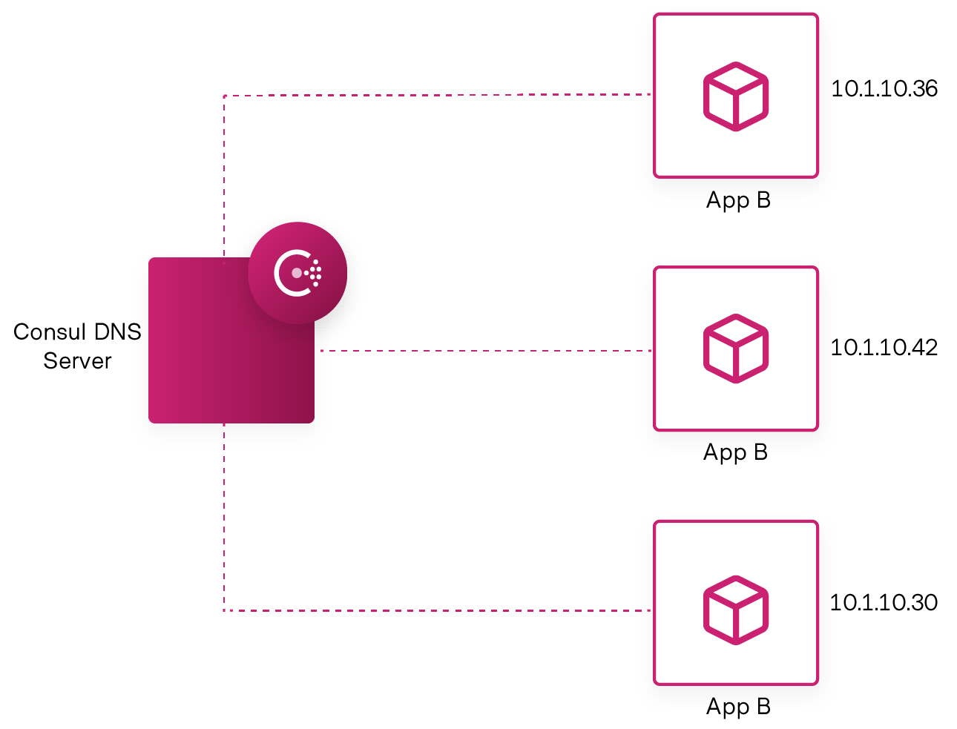
Service Discovery Using Consul
Discover, Register, and Resolve services for application workloads across any cloud.
Automatically add and remove services based on health checking.
> docker pull consul
> docker run -p 8500:8500 consul
//inside docker instance
> consul services deregister -id=web
Notes:
https://www.c-sharpcorner.com/article/building-api-gateway-using-ocelot-in-asp-net-core-service-discovery-consul/
Microservices architecture on Azure Kubernetes Service (AKS) - Azure Architecture Center | Microsoft Docs
The Kubernetes Service object provides a set of capabilities that match the microservices requirements for service discoverability:

Slide 6

Circuit Breaker Pattern
A circuit breaker is an electronic component like fuse that opens a circuit so that no current can flow through it. As a result, it prevents the damage caused by excess current from an overload or short circuit.
To prevent an application from trying to invoke a remote service or access a shared resource if this operation is highly likely to fail.
The circuit-breaker tracks the number of times an API call has failed. Once it crosses a threshold number of failures in a row, it doesn't even try to call the API for subsequent requests.
Notes:
A circuit breaker is an electronic component like fuse that opens a circuit so that no current can flow through it. As a result, it prevents the damage caused by excess current from an overload or short circuit.
This pattern isn't recommended:
For handling access to local private resources in an application, such as in-memory data structure. In this environment, using a circuit breaker would add overhead to your system.
As a substitute for handling exceptions in the business logic of your applications.
Implementing the Circuit Breaker pattern | Microsoft Docs
Circuit Breaker · App-vNext/Polly Wiki (github.com)

Slide 7
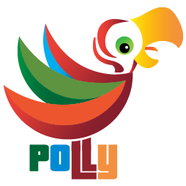
Polly
A .NET library that allows to express policies such as Retry, Circuit Breaker, Timeout, Bulkhead Isolation, and Fallback in a fluent and thread-safe manner.
If the failure scenario is occurring due to load issues (e.g. a database is trying to handle too many operations), a circuit-breaker policy will prevent the situation from getting worse whereas a retry policy would almost certainly have cause a bigger problem
public void ConfigureServices(IServiceCollection services)
{
services.AddHttpClient("basketapi")
.SetHandlerLifetime(TimeSpan.FromMinutes(5))
.AddPolicyHandler(GetCircuitBreakerPolicy());
}
static IAsyncPolicy<HttpResponseMessage> GetCircuitBreakerPolicy()
{
return HttpPolicyExtensions
.HandleTransientHttpError()
.CircuitBreakerAsync(2, TimeSpan.FromSeconds(10));
}
Notes:
App-vNext/Polly: Polly is a .NET resilience and transient-fault-handling library that allows developers to express policies such as Retry, Circuit Breaker, Timeout, Bulkhead Isolation, and Fallback in a fluent and thread-safe manner. From version 6.0.1, Polly targets .NET Standard 1.1 and 2.0+. (github.com)

Slide 8
Observability Patterns
Problem: How to understand the behavior of an application and troubleshoot problems?
Log aggregation - aggregate the application logs
Application metrics - instrument a service’s code to gather statistics about operations
Exception tracking - report all exceptions to a centralized exception tracking service that aggregates and tracks exceptions and notifies developers.
Health check API - service API (e.g. HTTP endpoint) that returns the health of the service and can be pinged, for example, by a monitoring service
Audit logging - record user activity in a database
Notes:
observability is a measure of how well internal states of a system can be inferred from knowledge of its external outputs. In contrast to monitoring which is something we actually do, observability (as a noun), is more a property of a system. Observability is Built on 3 Pillars.
Logging: collects information about events happening in the system. Helping the team analyze unexpected application behavior. Searching through the logs of suspect services can provide the necessary hint to identify the problem root cause. Such as: service throwing out of memory exceptions and app configuration not reflecting expected values. As well as calls to external service with incorrect address, calls to external service returns with unexpected results, and incoming requests with unexpected input.
Tracing: collects information to create an end-to-end view of how transactions are executed in a distributed system. A trace is like a stack trace spanning multiple applications. Once a problem has been recognized, traces are a good starting point in identifying the source in distributed operations. Like calls from service A to B are taking longer than normal, service payment calls are failing, etc.
Metrics: provide a real-time indication of how the system is running. It can be leveraged to build alerts, allowing proactive reactance to unexpected values. As opposed to logs and traces, the amount of data collected using metrics remains constant as the system load increases. Application problems are often first detected through abnormal metric values. Such as CPU usage being higher than before, payment error count spiking, and queued item count keeps growing.

Slide 9
Microservices Logging
Microservice Architecture
Microservice Architecture
Payment Service
Order Service
Payment Service
Order Service
Log Source
Log Source
Logging Framework
Logging Framework
Centralized Logging Service
Log Destination
Log Destination
Logging in Each Service
Centralized Logging Service

Slide 10
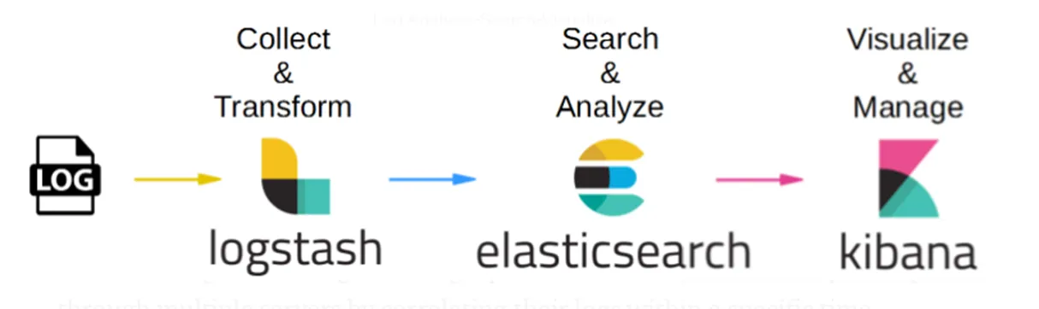
Logging with ELK Stack
Elastic Search is a NoSQL database that is capable of taking all logs, index them and making them searchable.
LogStash is a log collector for storing logs in a structured JSON format.
Kibana is a UI that can connect to Elastic Search and provide a usable interface for searching logs, making queries, and dashboards and charts out of those queries.

Slide 11
ELK Stack Docker Setup
> git clone https://github.com/deviantony/docker-elk.git
> cd docker-elk
Change Credential in .env file, if needed:
  - username:elastic
  - password:changeme
> docker-compose up setup
> docker-compose up
Accessing Dashboard
  Kibana: localhost:9200
    Elastic Search UI: localhost:5601
Create a custom index for logging using UI as:
  Management > Stack Management > Kibana > DataView > Create Data View
  OR: Management > Stack Management > Data > Index Management > Create Index
Notes:
Management > Stack Management > Kibana > DataView > Create Data View
Management > Stack Management > Data > Index Management > Create Index

Slide 12
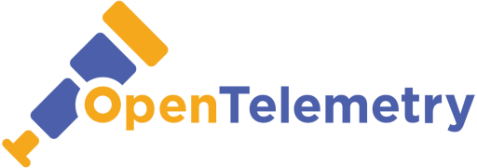
Open Telemetry
An observability framework for cloud-native software.
Used to the instrument, generate, collect, and export telemetry data (metrics, logs, and traces) for analysis in order to understand your software's performance and behavior.
Supports all officially supported versions of .NET Core and .NET Framework except for .NET Framework 3.5 SP1.
Zipkin is a distributed tracing system. It helps gather timing data needed to troubleshoot latency problems in service architectures.
docker run -d -p 9411:9411 openzipkin/zipkin
Notes:
Open Telemetry for ASP.NET Core - Muhammad Rehan Saeed
opentelemetry-dotnet/examples/AspNetCore at main · open-telemetry/opentelemetry-dotnet · GitHub

